Slide 1
Sparse Models
Pattern Recognition, 2023

Slide 2
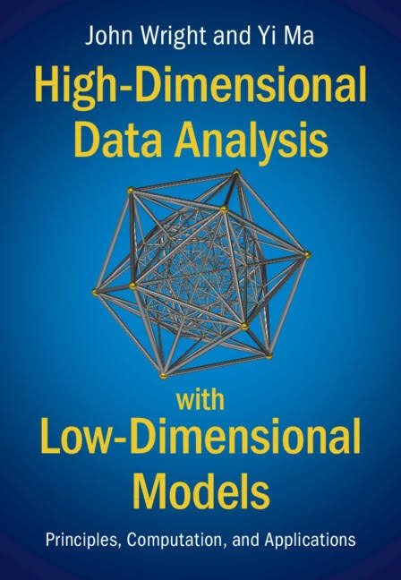

Main References
EECS208 (Computational Principles for High-dim Data Analysis) in UC Berkeley, by Prof. Yi Ma, et al.
Tutorials in ICASSP 2022: https://highdimdata-lowdimmodels-tutorial.github.io/calendar/
Book: High-Dimensional Data Analysis with Low-Dimensional Models, John Wright and Yi Ma, 2022
Tutorials (Convex Optimization for Statistics and Machine Learning) by Prof. Ryan Tibshirani.
CSIC5011 (Topological and Geometric Data Reduction and Visualization) in UST HK by Prof. Yuan Yao.
《最优化：建模、算法与理论》, 刘浩洋等 (北京大学 文再文教授组), 2020
https://bicmr.pku.edu.cn/~wenzw/optbook.html

Slide 3
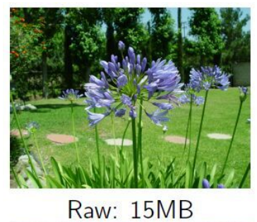
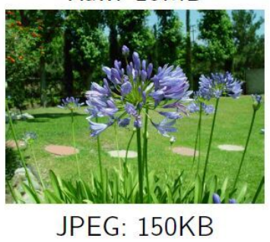
Motivation
Massive data acquisition
Most of the data is redundant and can be thrown away
Seems enormously wasteful

Slide 4
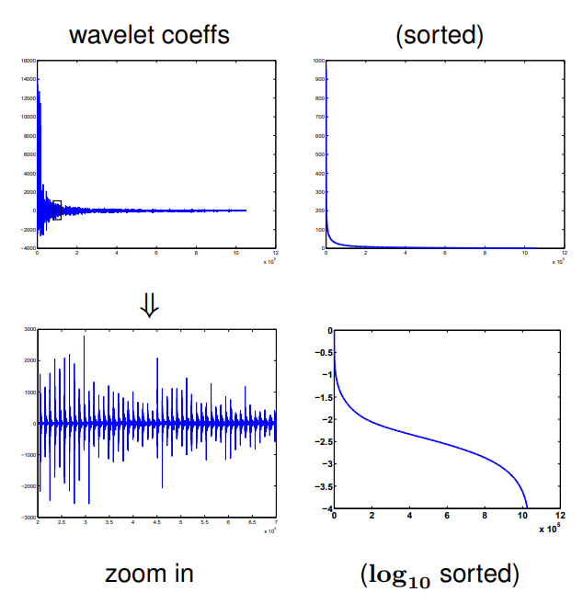
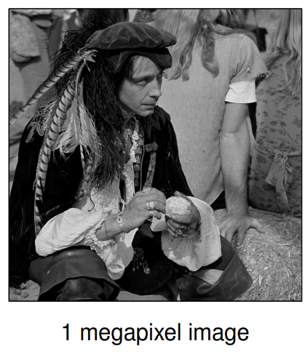
Wavelets and Images
Notes:
Sparsity in the spectral domain.

Slide 5
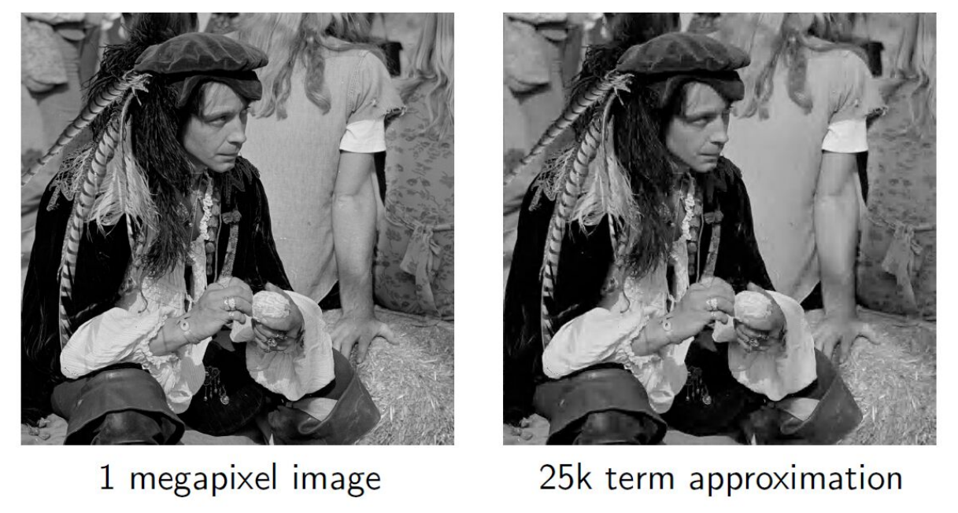
Sparsity and wavelet "compression"
Basis for JPEG2000 image compression standard

Slide 6
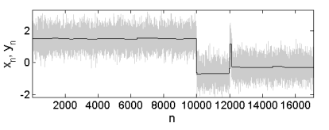
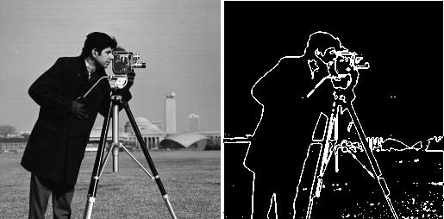
Sparsity of Gradient
The signal is smooth in most (local) regions.
Can change abruptly across edges.
Motivation of the use of total variation regularization.

Slide 7
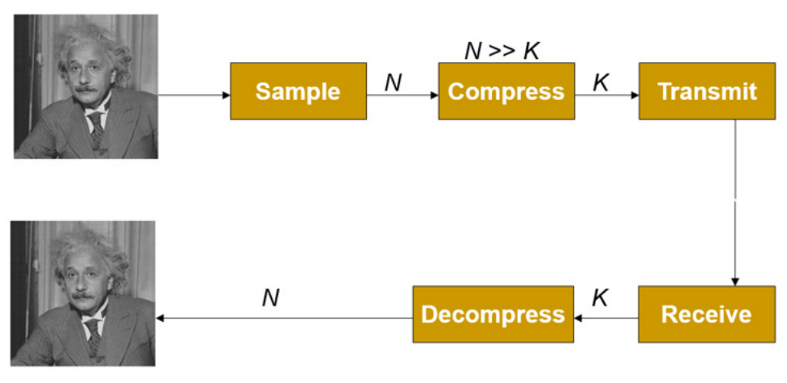
Conventional signal acquisition and compression
A lot of resources are spent at sampling and compress.
Undesirable for many applications, such as medical imaging (x-ray CT, MRI, …)
Is it possible to acquire a compressed version of the signal at the sampling stage?
Notes:
X-ray CT: fewer doses (of X-rays) are preferred
MRI: long processing time of taking one image

Slide 8
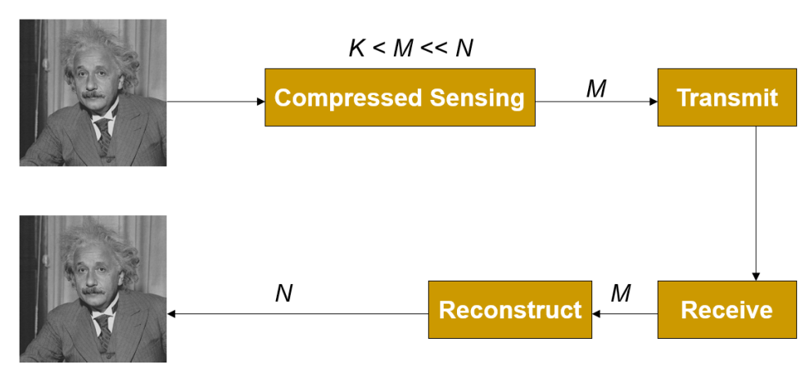
Compressed/Compressive Sensing
Key idea: exploit sparsity of the signals in a certain domain.

Slide 9
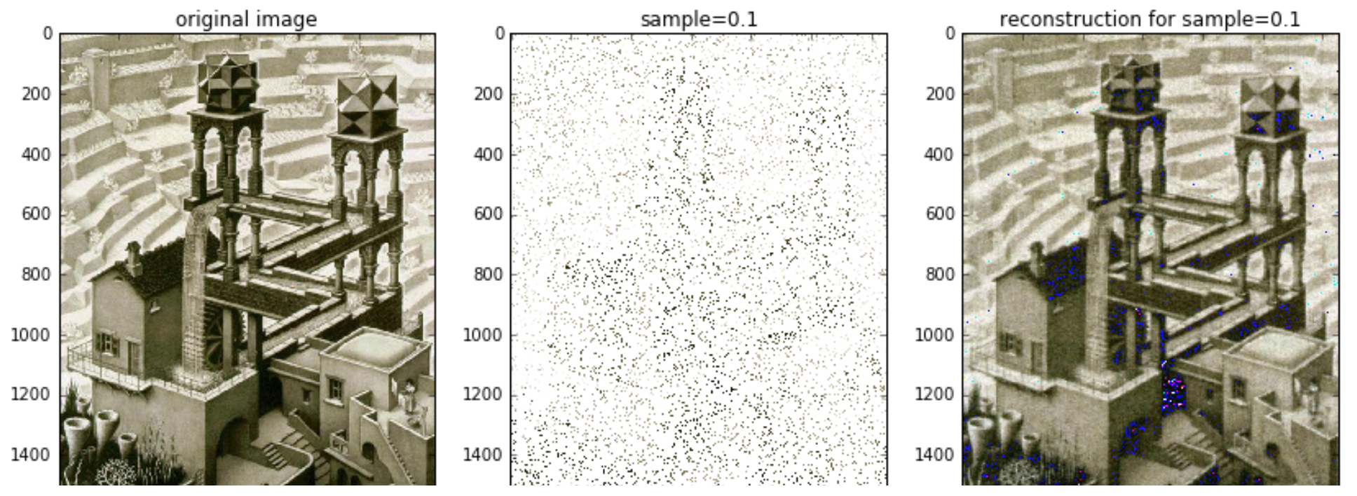
Compressed/Compressive Sensing

Slide 10
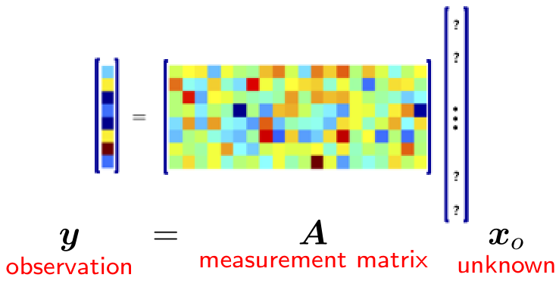
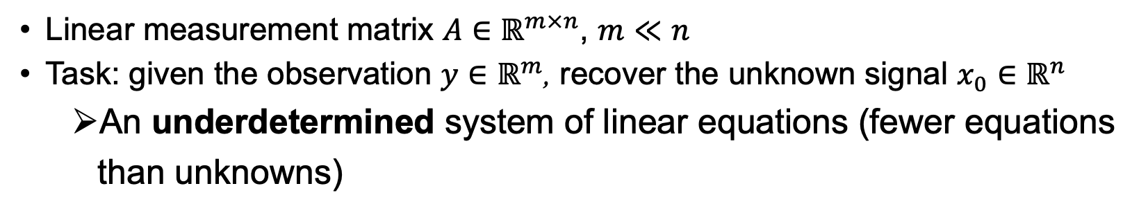
Compressed Sensing – Problem Formalism
Linear measurement matrix $A∈ℝ^{m×n}$, $m≪n$
Task: given the observation $y∈ℝ^{m}$, recover the unknown signal $x_{0}∈ℝ^{n}$
An underdetermined system of linear equations (fewer equations than unknowns)
Notes:
m << n since we want “compressed” sensing.

Slide 11
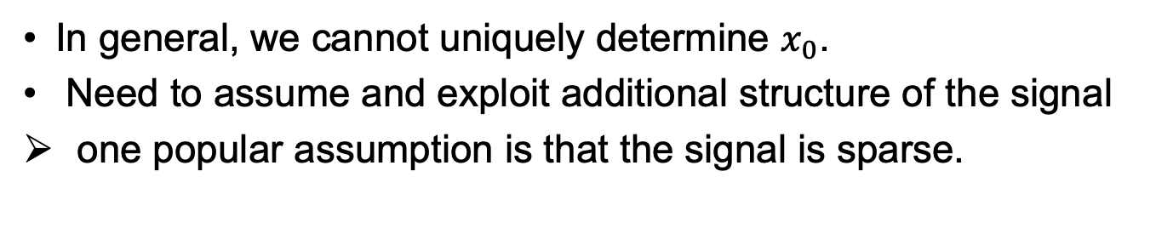
Compressed Sensing – Problem Formalism
In general, we cannot uniquely determine $x_{0}$.
Need to assume and exploit additional structure of the signal
one popular assumption is that the signal is sparse.

Slide 12
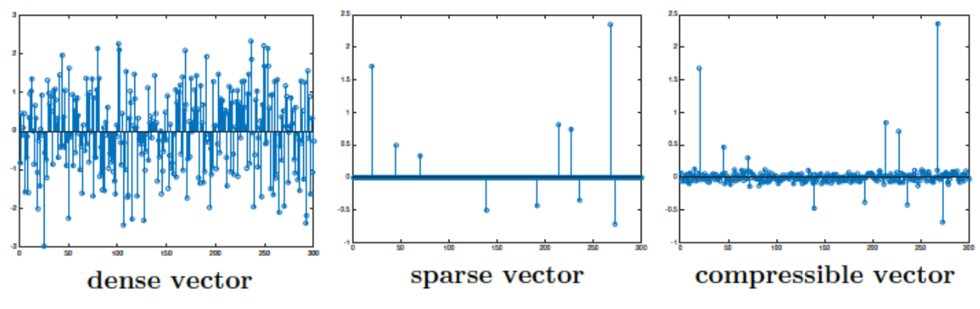
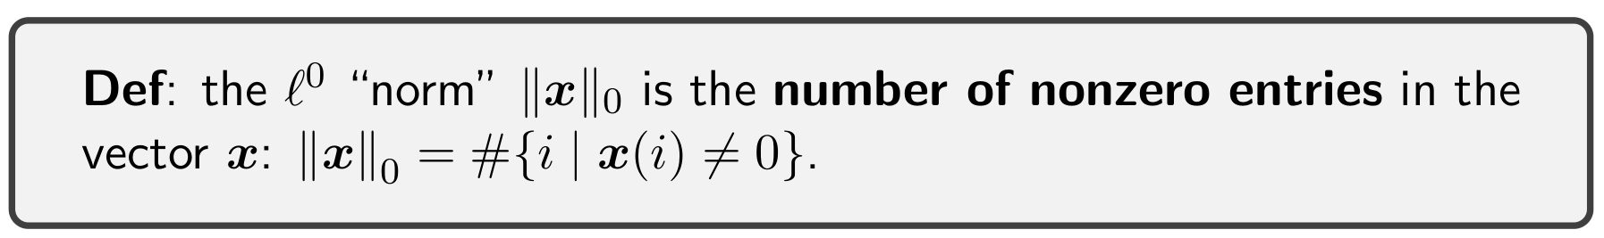
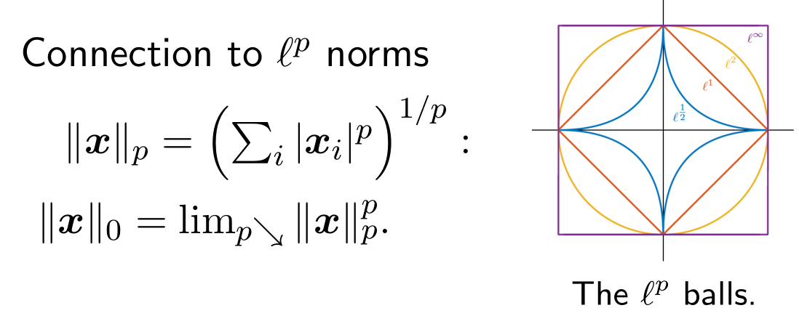
Sparse Signals

Slide 13
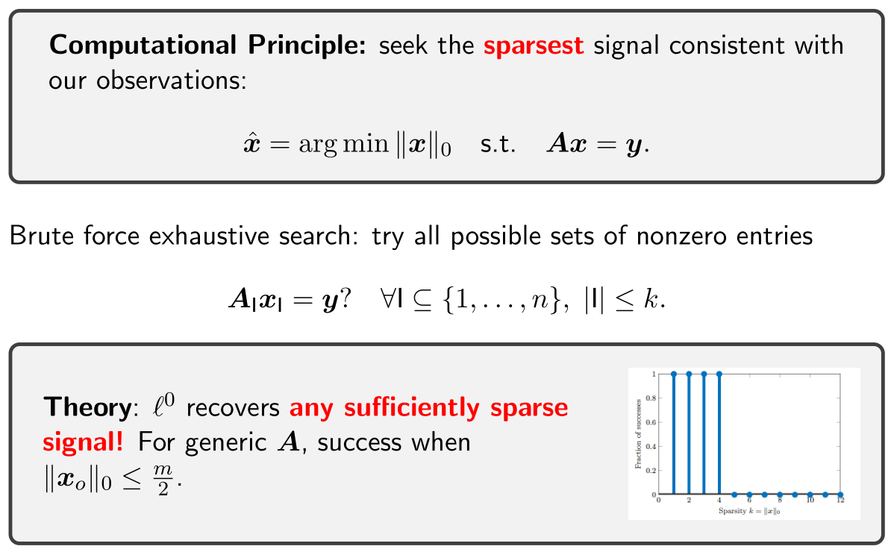
Sparse Recovery: $ℓ^{0}$ minimization
Notes:
Note: the sparsity level required by this theory can be too strict for real applications.

Slide 14
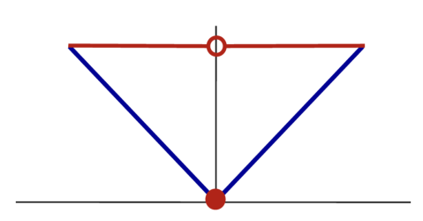
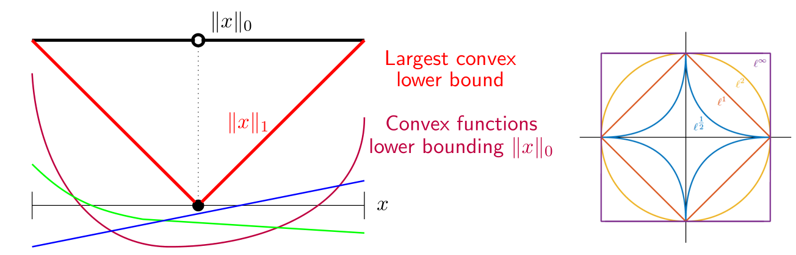
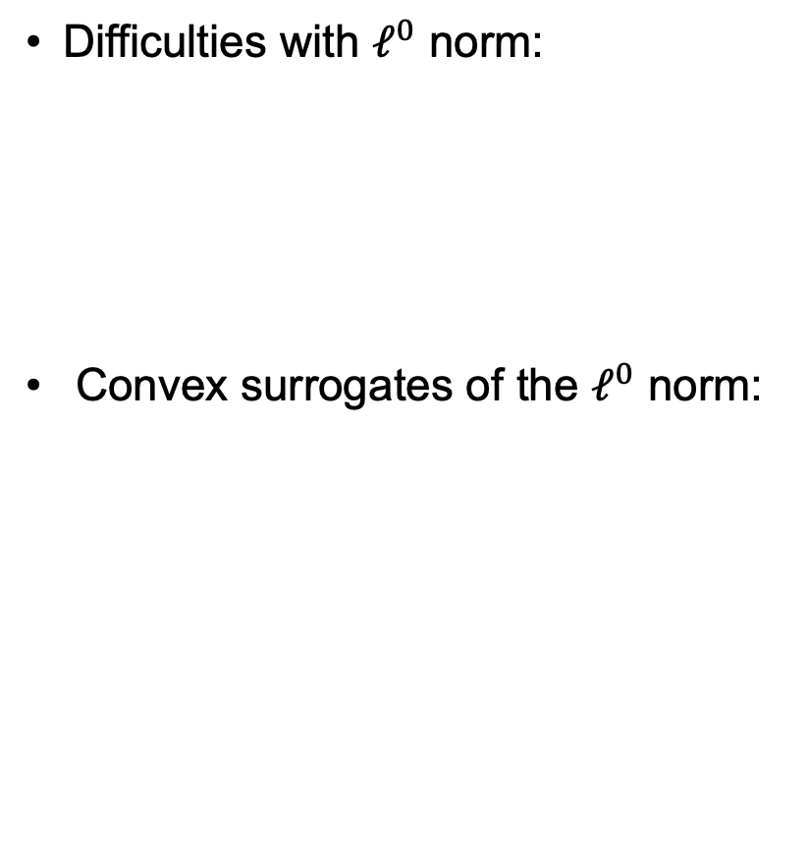
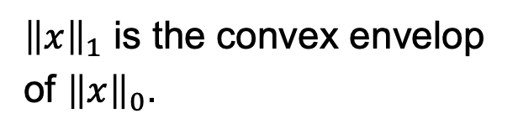
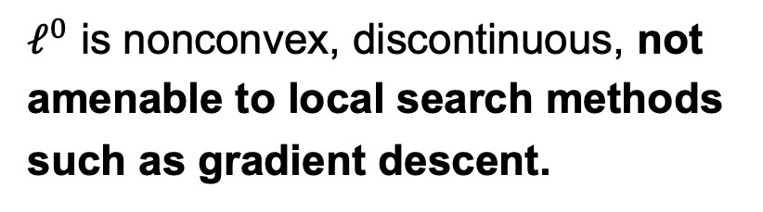
Convex Relaxation
Difficulties with $ℓ^{0}$ norm:
Convex surrogates of the $ℓ^{0}$ norm:
$ℓ^{0}$ is nonconvex, discontinuous, not amenable to local search methods such as gradient descent.
${\left\|x\right\|}_{1}$ is the convex envelop of ${\left\|x\right\|}_{0}$.

Slide 15
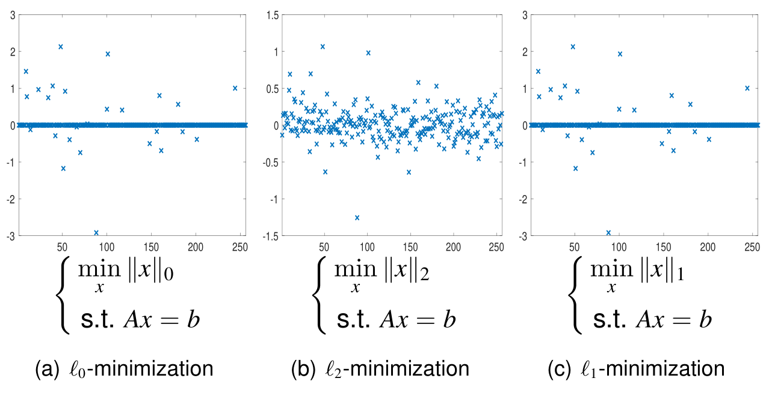
Convex Relaxation: $ℓ^{1}$ minimization
Efficient convex relaxation (also called Basis pursuit):
Solvable quickly at large scale using dedicated methods.
Example:
let n=256, m=128
Notes:
Q: (1) Why l1 minimization yields sparse solution?
(2) Guarantee of recovery?

Slide 16
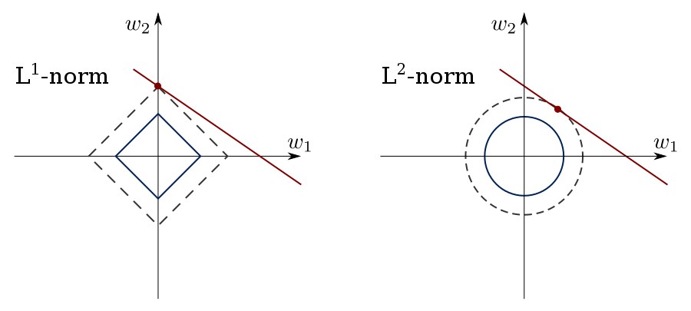
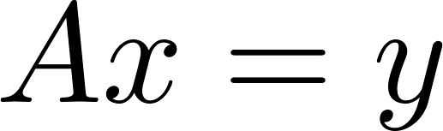
$ℓ^{1}$ minimization yields sparse solutions

Slide 17
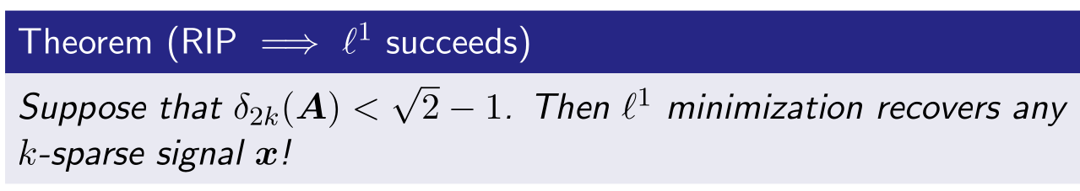
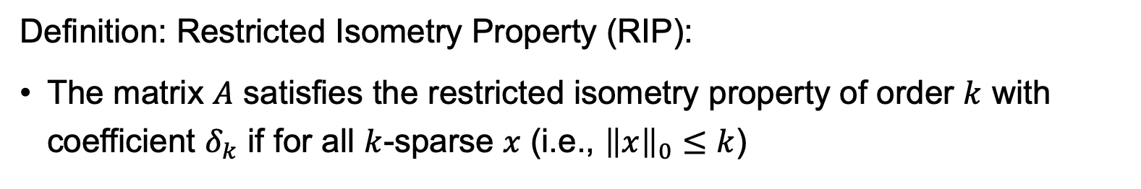
Sufficient Condition for $ℓ^{1}$ Recovery
Definition: Restricted Isometry Property (RIP):
The matrix $A$ satisfies the restricted isometry property of order $k$ with coefficient $δ_{k}$ if for all $k$-sparse $x$ (i.e., ${\left\|x\right\|}_{0}≤k$)

Slide 18
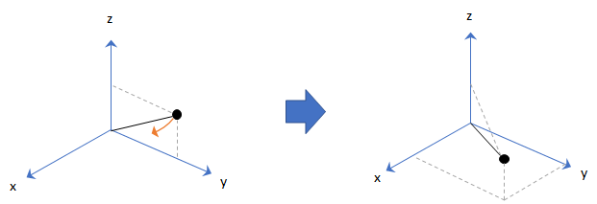
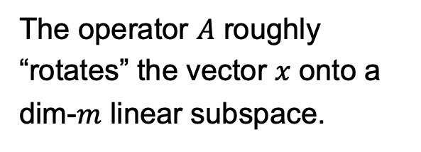
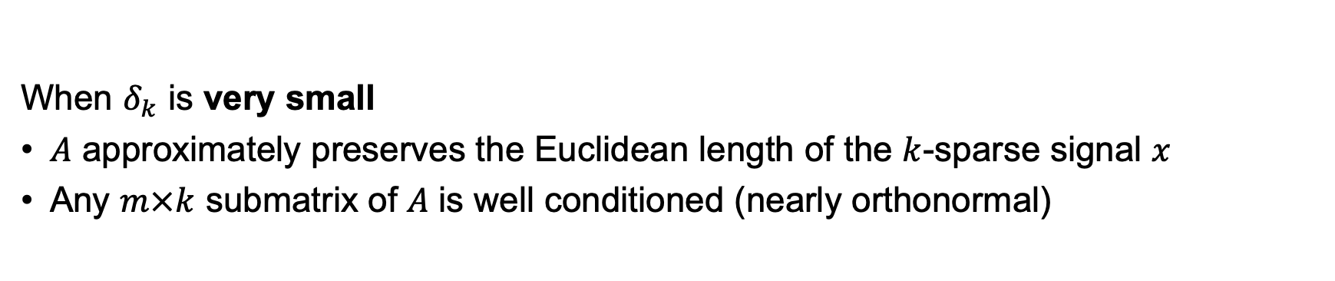
Restricted Isometry Property
When $δ_{k}$ is very small
$A$ approximately preserves the Euclidean length of the $k$-sparse signal $x$
Any $m×k$ submatrix of $A$ is well conditioned (nearly orthonormal)
The operator $A$ roughly “rotates” the vector $x$ onto a dim-$m$ linear subspace.

Slide 19
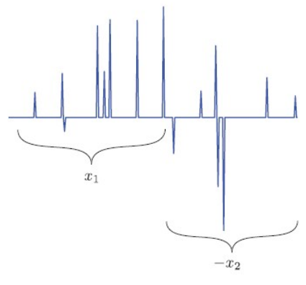
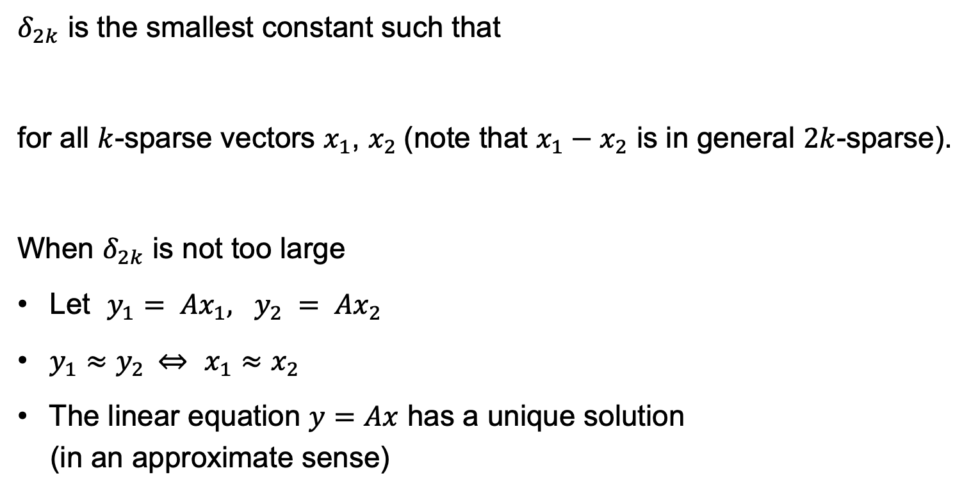
RIP for Sparse Signal Recovery
$δ_{2k}$ is the smallest constant such that
for all $k$-sparse vectors $x_{1}$, $x_{2}$(note that $x_{1}−x_{2}$ is in general $2k$-sparse).
When $δ_{2k}$ is not too large
Let $y_{1}= Ax_{1}, y_{2} = Ax_{2}$
$y_{1}≈y_{2}$⇔ $x_{1}≈x_{2}$
The linear equation $y=Ax$ has a unique solution
(in an approximate sense)
Notes:
Otherwise, A*x1 – A*x2 = 0, but ||x1 - x2||^2 > 0, contradicting RIP.

Slide 20
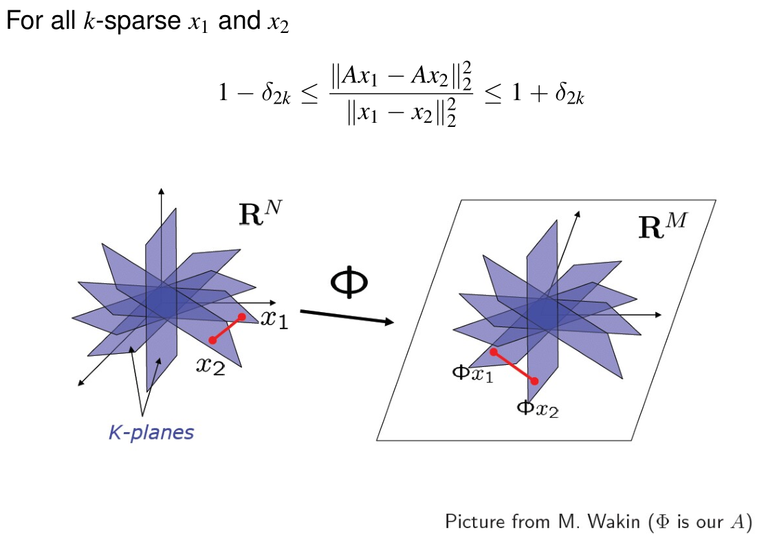
RIP for Sparse Signal Recovery
Notes:
Case of non-unique solution:
x1 – x2 != 0, but after the measurement by A, it becomes A*x1 – A*x2 = 0.
RIP gives a restriction that this will not happen.

Slide 21
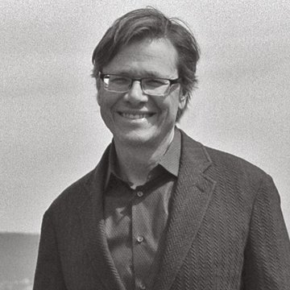

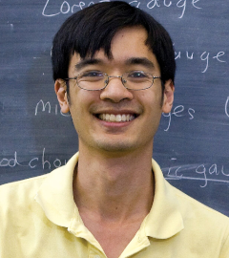
Big Figures in the Field
David Donoho
(Awarded the 2013 Shaw Prize for his contribution in the field)
Emmanuel Candès
Terence Tao
(Candès and Tao proposed RIP in 2005)

Slide 22
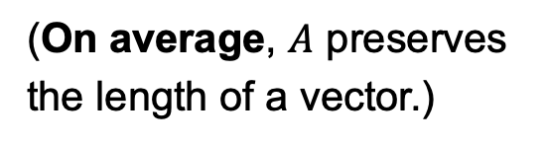
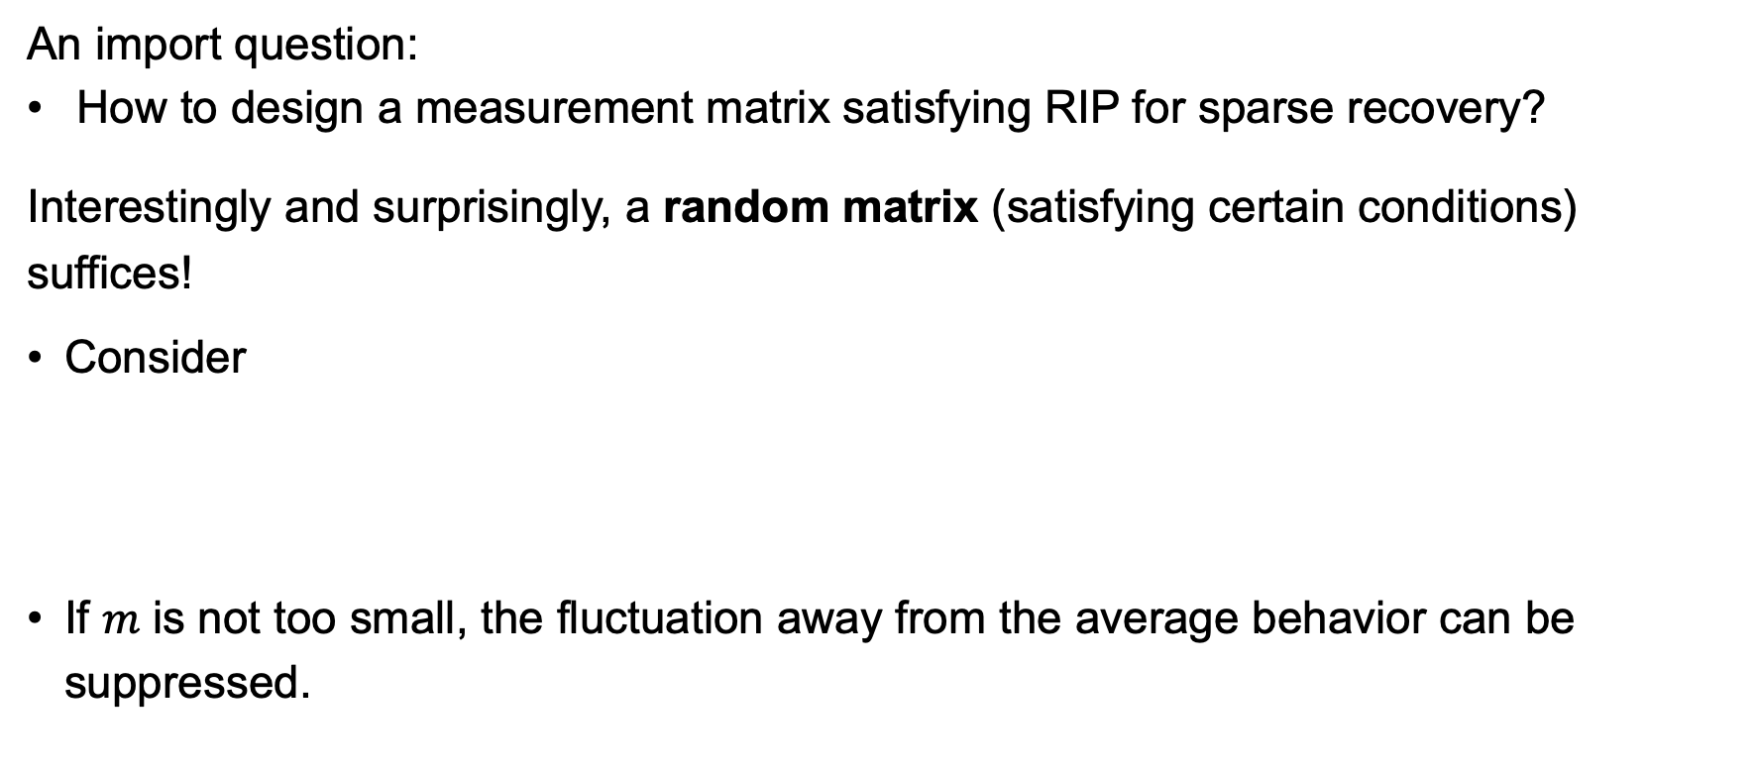
Matrices Satisfying RIP
An import question:
How to design a measurement matrix satisfying RIP for sparse recovery?
Interestingly and surprisingly, a random matrix (satisfying certain conditions) suffices!
Consider
If $m$ is not too small, the fluctuation away from the average behavior can be suppressed.
(On average, $A$ preserves the length of a vector.)

Slide 23
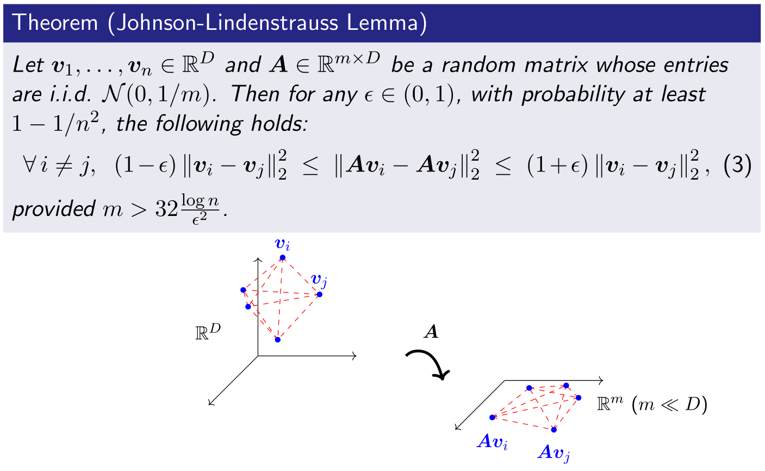
Matrices Satisfying RIP
Random projection !
Notes:
Random projection. Proof by using concentration inequalities.

Slide 24
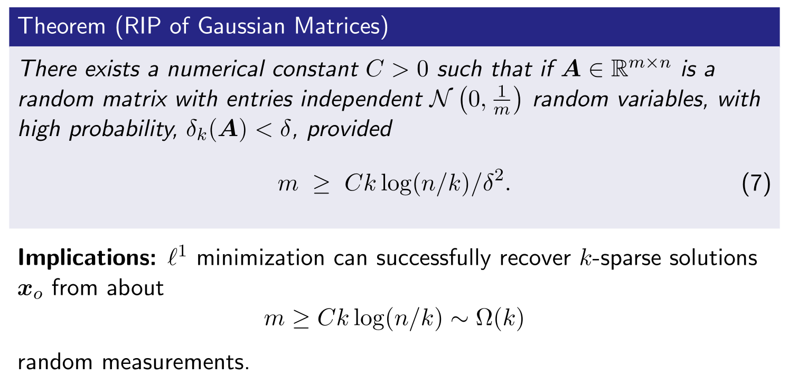
Sufficient Condition for $ℓ^{1}$ Recovery
The theorem only establishes the orders of growth, but not the precise estimates of the constant $C$.

Slide 25
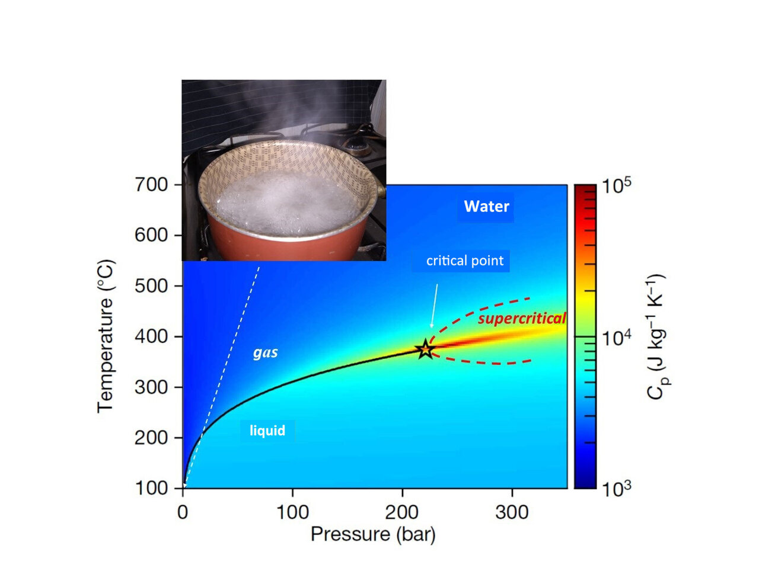
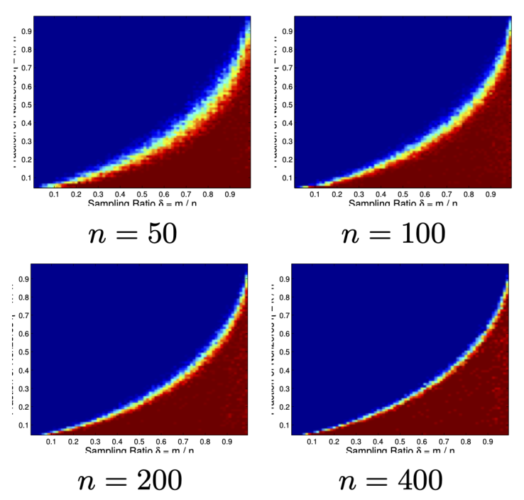
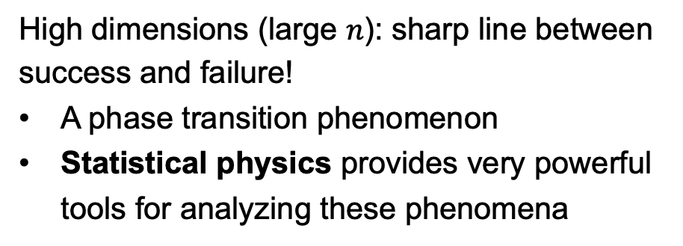
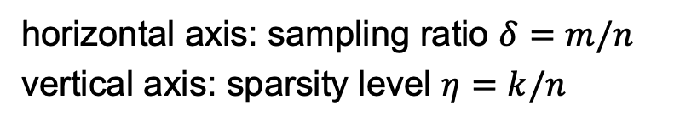
Phase Transition in Sparse Recovery
High dimensions (large $n$): sharp line between success and failure!
A phase transition phenomenon
Statistical physics provides very powerful tools for analyzing these phenomena
horizontal axis: sampling ratio $δ=m/n$
vertical axis: sparsity level $η=k/n$

Slide 26
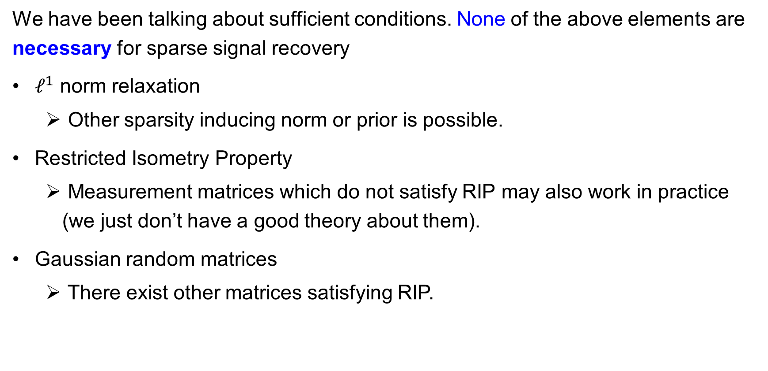
Remark
We have been talking about sufficient conditions. None of the above elements are necessary for sparse signal recovery
$ℓ^{1}$ norm relaxation
Other sparsity inducing norm or prior is possible.
Restricted Isometry Property
Measurement matrices which do not satisfy RIP may also work in practice (we just don’t have a good theory about them).
Gaussian random matrices
There exist other matrices satisfying RIP.

Slide 27
Algorithm – Linear Programming Formulation
Basis pursuit
Equivalent to
Can be solved right away by any linear programming solver
Suitable for problems of moderate sizes
More efficient algorithms are needed for large-scale problems

Slide 28
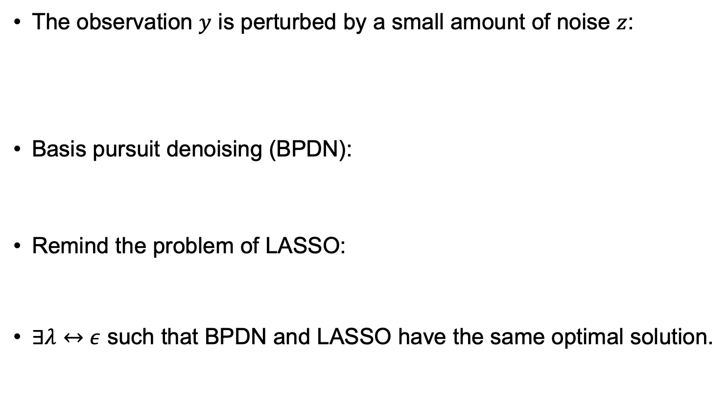
Noisy Observations
The observation $y$ is perturbed by a small amount of noise $z$:
Basis pursuit denoising (BPDN):
Remind the problem of LASSO:
$∃λ↔ε$ such that BPDN and LASSO have the same optimal solution.
Can be solved right away by any convex optimization solver.
Notes:
Notation in statistics: Y = X*beta instead of y = A*x

Slide 29
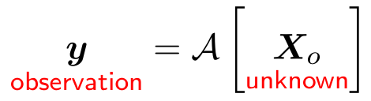
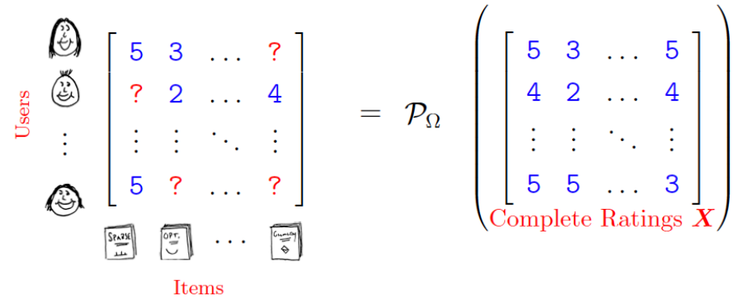

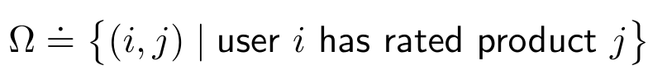
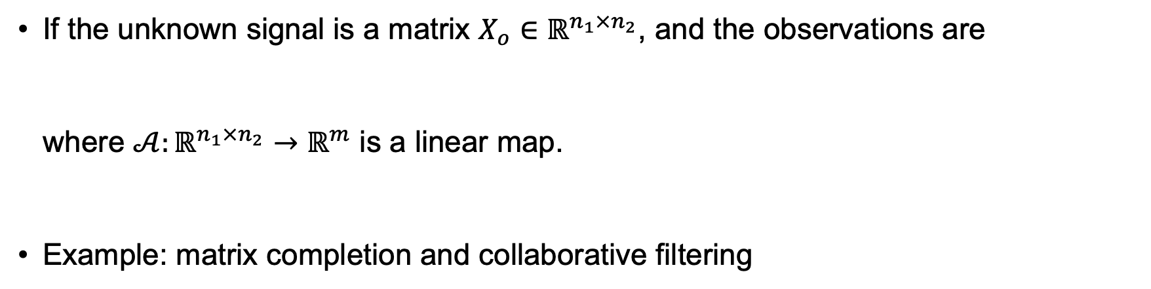
Extension to Matrix Recovery/Completion
If the unknown signal is a matrix $X_{o}∈ℝ^{n_{1}×n_{2}}$, and the observations are
where $𝒜:ℝ^{n_{1}×n_{2}}→ℝ^{m}$ is a linear map.
Example: matrix completion and collaborative filtering

Slide 30


Collaborative Filtering
The Netflix challenge.
Target: complete the rating matrix so as to predict a user’s preferences on movies
Recommend the movies with high predicted ratings to the users
A matrix completion problem.

Slide 31


Matrix Recovery/Completion
Also under-determined if $m<n_{1}×n_{2}$.
Need some structure of the signals, such as sparsity in compressed sensing.
Remind that, in collaborative filtering, only a few latent factors are assumed:
Collaborative filtering assumes a low-rank structure of the rating matrix.

Slide 32

Latent Factors in Matrix Recovery
Koren et al, 2009

Slide 33




Rank and Singular Value Decomposition
Many tools and ideas from sparse signal recovery apply!
Note: the decomposition “$X=UV^{⊤}$” in the previous page differs from SVD.
Those “$U$” and “$V^{⊤}$” are in general not orthogonal matrices.

Slide 34


Affine Rank Minimization

Slide 35

Convex Relaxation: Nuclear Norm Minimization

Slide 36

Parallelism between Rank and Sparsity

Slide 37
Matrix Completion
Convex relaxation of the rank minimization problem
With noisy observations, we work with

Slide 38
Algorithms for Sparse Signal Recovery

Slide 39


Convex Non-smooth Problems
(e.g., reconstruction error)
(e.g., $ℓ^{1}$-norm or Nuclear norm regularization)
1st challenge: when $n$ is very large, and non-smoothness exists
Second order methods ⇒ First order methods...
Gradient descent ⇒ Subgradient method (replace gradient by any $g∈∂F(x)$)
2nd challenge: subgradient methods are slow for non-smooth functions
Proximal methods and further acceleration
Equality Constraints: Augmented Lagrange multiplier (ALM)
Separable Structures: Alternating direction of multipliers method (ADMM)

Slide 40

Proximal Operator
Intuition: looks for the minimum of $g(x)$ in the vicinity of $w$.
If $g(x)$ is convex, $\frac{1}{2}{\left\|x−w\right\|}_{2}^{2}+g(x)$ is strongly convex.
Flexible for dealing with non-smooth functions and constraints.
Very useful if the proximal mapping has closed-form and can be computed efficiently!

Slide 41

Proximal Methods
Revisiting gradient method for smooth problems
We want to solve a smooth optimization problem: $\min_{x∈ℝ^{n}}{f(x)}$
Arrived at $x^{k}$ at iteration $k$. Adopt a quadratic approximation of $f(x)$
Equivalently:
Solution is the gradient descent algorithm:
(More sophisticated methods are possible by modifying this quadratic approximation, e.g., Newton’s method and mirror descent.)
Notes:
Note: we’ve approximated the Hessian by an identity matrix -> neglect the anisotropic local curvature information.

Slide 42

Proximal Methods
Dealing with smooth plus non-smooth problems
We want to solve a non-smooth optimization problem: $\min_{x∈ℝ^{n}}{f\left(x\right)}+g(x)$
Arrived at $x^{k}$ at iteration $k$. Adopt a quadratic approximation of $f(x)$
Equivalently:
Solution is the proximal gradient algorithm:

Slide 43

Proximal Gradient for $ℓ^{1}$-regularization
$ℓ^{1}$-regularization problem (basis pursuit denoising or LASSO):
Proximal gradient update:
Break it down to two steps:
Here, $∇f\left(x^{k}\right)=A^{∗}(Ax−y)$. Need to compute ${prox}_{t{\left\|⋅\right\|}_{1}}(⋅)$ with $t=α_{k}λ$.

Slide 44



Proximal Gradient for $ℓ^{1}$-regularization
Optimality condition: $0∈x−w+t∂{\left\|x\right\|}_{1}$
Remind:
In summary:
${prox}_{t{\left\|⋅\right\|}_{1}}(⋅)$ is the soft-thresholding operator.
Denoted as ${soft}_{t}(⋅)$

Slide 45



Proximal Gradient for $ℓ^{1}$-regularization
For reaching the optimum up to some error $ε$
Subgradient method requires $O(1/\sqrt{k})$ iterations
Proximal gradient requires $O(1/k)$ iterations (same rate as gradient descent for smooth (but not strongly) convex functions)
Notes:
Step size: can also use line search.

Slide 46

From ISTA to Learned ISTA (LISTA) (optional)
⁴Learning Fast Approximations of Sparse Coding, Karol Gregor and Yann LeCun, ICML 2010.
Notes:
An interesting research topic: info/signal processing point of view of deep neural network.

Slide 47


Accelerated Gradient Descent
Recall gradient descent for smooth problems $\min_{x}{f(x)}$:
The heavy ball (momentum) method
Basis of the popular ADAM algorithm for training deep neural networks.
Worst convergence rate is still $O(1/k)$, yet best possible is $O(1/k^{2})$.

Slide 48

Accelerated Gradient Descent (optional)
[Nesterov, 1983]

Slide 49


Accelerated Proximal Gradient (optional)
Known as Fast ISTA (FISTA) when applied to BPDN/LASSO.

Slide 50



Other Options and Comparisons
Stochastic gradient descent
(Blocked) coordinate descent (used in glmnet for LASSO)
Alternating Direction Methods of Multipliers (ADMM)
(will come back to this later.)
Notes:
Shall we simply stick to coordinate descent?

Slide 51





Why do we need so many different algorithms?
The 2d fused lasso or 2d total variation denoising problem:
This fits a piecewise smooth/constant function over an image, given data $y_{i}$ at all pixels.
Specialized ADMM, 20 iterations
Proximal gradient descent, 1000 iterations
Coordinate descent, 10K cycles
[R. Tibshirani]
Different algorithms will perform better or worse in different situations (no free lunch theorem).

Slide 52
Algorithms for Matrix Recovery

Slide 53
Recall: Nuclear Norm Minimization
Recall that in matrix recovery/completion problems, we aim to find a “sparse” solution:
Relax the difficult rank minimization problem to the convex nuclear norm minimization problem:

Slide 54

SDP Approach to Nuclear Norm Minimization
The nuclear norm ${\left\|X\right\|}_{∗}$ of a matrix $X∈ℝ^{m×n}$ has a semidefinite representation
Semidefinite programming (SDP) approach to matrix completion
Suitable for problems of small/moderate sizes.
[B. Recht, et al., "Guaranteed Minimum-Rank Solutions of Linear Matrix Equations via Nuclear Norm Minimization", 2007]

Slide 55

SDP Representation of Matrix Norms (optional)
Let $X∈ℝ^{m×n}$.
SVD: $X=UΣV^{⊤}$, with singular values $σ_{i}=Σ_{ii}$
Spectral norm: ${\left\|X\right\|}_{2}=σ_{max}(X)$
Concept of dual norm:
For a given matrix norm $\left\|⋅\right\|$, the dual norm is defined as
Nuclear norm and spectral norms are dual to each other

Slide 56

SDP Representation of Matrix Norms (optional)
Recall that ${\left(σ_{i}\left(Z\right)\right)}^{2}$ is an eigenvalue of $ZZ^{⊤}$ or $Z^{⊤}Z$
Then
By the Schur complement argument:
SDP representation of the nuclear norm ${\left\|X\right\|}_{∗}$
(Alert: require some efforts to show this.)

Slide 57
Proximal Gradient to Nuclear Norm Regularization
For large problems, we usually resort to first order methods as before.
Consider the unconstrained nuclear-norm regularized problem
This is analogous to BPDN or LASSO:
Proximal gradient method for BPDN:

Slide 58

Proximal Gradient to Nuclear Norm Regularization
Similar formalism applied to the matrix recovery problem
The corresponding proximal gradient method:
where
Let , then
with the soft-thresholding operator:

Slide 59


Non-convex Approach to Matrix Recovery
The convex approaches discussed above may still be too costly for large-scale problems.
Many recent approaches directly minimize under $UV^{⊤}$ parameterization
A non-convex problem.
Solutions have a rotational symmetry $UV^{⊤}=(UΓ)(Γ^{−1}V^{⊤})$.
Interestingly, under some conditions, local minimizers are globally optimal.

Slide 60
Both Low-rank and Sparsity?

Slide 61


PCA – Matrix Decomposition Perspective
Let $Y∈ℝ^{p×n}$ be an observed data matrix. Classical PCA looks for a matrix decomposition:
$Y=L+S$
where
$L$ is of low-rank (e.g. at most rank $k$),
the error matrix $S$ has a small Frobenius norm, which is usually the case for Gaussian noise.
SVD provides a solution:

Slide 62

PCA is sensitive to outliers
However, if some outliers exists, i.e. there are a small amount of sample points which are largely deviated from the main population of samples.
The classical PCA is well-known very sensitive to such outliers.

Slide 63

Combining Low-rank and Sparsity
Assume that the outliers are sparse!
In the decomposition $Y=L+S$, we now require
$L$ is of low-rank (e.g. at most rank $k$)
$S$ is sparse (many zero elements)
Robust PCA

Slide 64

Applications - Moving objection detection

Slide 65



Applications - Moving objection detection
Ideas:

Slide 66

Robust PCA Formulation
In Robust PCA, the purpose is to solve
where ${\left\|A\right\|}_{0}=\#\{A_{ij}≠0\}$.
However both the objective function and the constraint are non-convex, whence it is difficult to solve in general.
As before, we would like to apply convex relaxation to make it more tractable.

Slide 67

Convex Relaxation of Robust PCA
The simplest convex relaxations:
Convex formalism of Robust PCA:
(Optional) Remind that the nuclear norm ${\left\|L\right\|}_{∗}$ has a semi-definite representation

Slide 68
Robust PCA via SDP (Optional)
The relaxed Robust PCA problem can be solved by the following semidefinite programming (SDP)
Again, this is suitable for problems of small/moderate sizes.
For problem of large sizes, we would resort to more specialized methods.

Slide 69
Alternating Direction Methods of Multipliers (ADMM)
The convex formalism of Robust PCA:
It admits a two-block structure with equality constrains
Such problems can be effectively tackled by ADMM
an extension of the augmented Lagrangian method,
useful for breaking down one big problem to many small subproblems to solve,
a generic and powerful method for solving large-scale problems in statistical learning.

Slide 70
Why ADMM is generic?
It seems this form is restricted rather than generic? Let’s look at some examples:
Unconstrained optimization:
Variables with linear transformation:
Global consensus optimization:

Slide 71


ADMM – Idea
We would like to find the saddle point $(x^{∗},λ^{∗})$ of the Lagrangian:
To achieve this, perform dual ascent by iterating:
minimization over the primal variables $x,z$
gradient ascent over the dual variables $λ$
To facilitate convergence, we introduce the augmented Lagrangian

Slide 72



ADMM – Algorithm
Problem:
Lagrangian:
Augmented Lagrangian:
(Basic) ADMM algorithm: repeats the following steps, for $k=1,2,3,…$
(a) fix $z$ and $λ$, minimize $x$:
(b) fix $x$ and $λ$, minimize $z$:
(c) fix $x$ and $z$, take a dual ascent step on $λ$:
Dual feasibility for “$z$-direction”
step size $=ρ$

Slide 73

ADMM for Robust PCA – (1)
Problem:
Augmented Lagrangian:
ADMM algorithm: repeats the following steps, for $k=1,2,3,…$
(a) fix $S$ and $Λ$, minimize $L$,
(b) fix $L$ and $Λ$, minimize $S$,
(c) fix $L$ and $S$, take a dual ascent step on $Λ$.
In subroutine (a):

Slide 74

ADMM for Robust PCA – (2)
Problem:
Augmented Lagrangian:
ADMM algorithm: repeats the following steps, for $k=1,2,3,…$
(a) fix $S$ and $Λ$, minimize $L$,
(b) fix $L$ and $Λ$, minimize $S$,
(c) fix $L$ and $S$, take a dual ascent step on $Λ$.
In subroutine (b):

Slide 75


ADMM for Robust PCA – (3)
Problem:
Augmented Lagrangian:
ADMM algorithm: repeats the following steps, for $k=1,2,3,…$
(a) fix $S$ and $Λ$, minimize $L$,
(b) fix $L$ and $Λ$, minimize $S$,
(c) fix $L$ and $S$, take a dual ascent step on $Λ$.
Reminiscent of neural networks?
See Prof. Yi Ma’s recent works on white-box deep networks.
Notes:
For practical considerations, e.g., how to choose $λ$, see [Wright and Ma 2022].
Theoretical analysis suggests: $λ=1/\sqrt{\max{(n_{1},n_{2})}}$.

Slide 76

Application: Video Surveillance

Slide 77

Application: removing imperfections from face images

Slide 78

ADMM – Summary
Easy to implement and use, and scalable for large-scale problem.
Under modest conditions on $f$ and $g$, ADMM converges to optimal solutions.
Convergence rate is about $O(1/k)$ (like general first order methods)
Slow to reach high accuracy,
But in many statistical learning problems, this is not a big issue
E.g., in many cases when training a statistical model, we are not interested in obtaining zero training errors, but care more about the generalization behaviors.

Slide 79
Sparse Coding/Representation

Slide 80
Sparsity under what representation?
Problem: the simple choice of basis functions may not yield the sparsest models.
Or in some applications, we even don’t have a clue of what representation to use for obtaining a sparse model.
Idea: learn the representation from data.

Slide 81



Sparse Coding (Dictionary Learning)
Assume $x=\sum_{k=1}^{K}{α_{k}D_{k}}$ (in matrix form: $x=Dα$)
Learning
Given training data $x_{i}, i=1,2,…,m$
Learn the dictionary $D$ and the sparse code $α_{i}$
Encoding
Given test data $x$ and the dictionary $D$
Learn the sparse code $α$
Notes:
Di is a dim-N column of the matrix D.

Slide 82

Sparse Coding (Dictionary Learning)
We can formulate the following $ℓ^{1}$-regularization problem for dictionary learning
It looks like compressed sensing/LASSO, but in fact it is not. Here, we have to learn the dictionary $D$ as well.
A non-convex problem, but we can use methods introduced in previous sections.
The learned dictionary $D$ constitutes the bases vectors $\{d_{i}\}$ for representing a signal $x$ in a sparse manner.
Very useful for many downstream applications.

Slide 83

Sparse coding for image inpainting
[Mairal, J., M. Elad, and G. Sapiro, “Sparse representation for color image restoration”, IEEE Trans. on Image Processing 17 (1), 53–69, 2008]

Slide 84




Sparse Coding and Efficient Coding Hypothesis
Efficient Coding Hypothesis (ECH)
Neural systems of creatures make efficient use of neural resources to representing natural stimuli (adapted by natural selection).
Ability to represent sensory signals with only a small fraction of neurons having to fire (e.g. to save energy).
Sparse coding of natural images results in sparse representations which is in a strike resemblance to the representations in the primary visual cortex! (supporting ECH?)
Receptive field for a simple cell in v1
Natural scene image
[Olshausen and Field, Nature 1996]
Notes:
“ICA and NMF have similar features, but not PCA.”

Slide 85

Features Learned in Convolutional Neural Networks
[Zeiler and Fergus 2013]
Does a CNN (implicitly) perform sparse coding?
Does a CNN mimic the behavior of a visual cortex?

Slide 86
Some Resources for Implementation
Convex optimization
Many existing software (e.g., CVX in Matlab, CVXPY in Python, Convex.jl in Julia).
Pick your favorite programming language.
Specialized algorithms
Prof. Zaiwen Wen’s website on the companion textbook: https://bicmr.pku.edu.cn/~wenzw/optbook/pages/contents/contents.html
Prof. Stephen P. Boyd’s website on ADMM: https://stanford.edu/~boyd/admm.html
…
Sparse coding for computer vision
Monograph: “Sparse Modeling for Image and Vision Processing” by J. Mairal et al. (available at https://arxiv.org/abs/1411.3230)
Companion software: http://thoth.inrialpes.fr/people/mairal/spams/downloads.html

Slide 87

Summary
Models: Sparse and Low-rank provide a flexible toolkit for modeling high-dimensional signals
Compressed sensing and matrix completion Provable exact recovery under some condition
LASSO, robust PCA, dictionary learning, …
Computation:
Convex relaxations by $ℓ^{1}$ norm, nuclear norm. Use direct convex optimization for small problems, specialized algorithms for large problems (proximal, ADMM, CD, …)
Non-convex formalism if the convex approach is still inefficient
Many interesting applications.

